Slide 1


SECRET COMMUNICATION ON MULTIMEDIA FORENSICS
Supervision by: Mr. Ajeet Kumar Sharma
Add Photo
Add Photo
Add Photo
Add Photo
Aditi Saraswat
Gagan Tiwari
Kamini Sengar
Priyanka Singh

Slide 2






Index of Presentation
01
Introduction
04
Proposed Methodology
02
Literature Reviews
05
Results & Experiments
Research Gap Motivation
03
06
Conclusion & Future Work
07
References

Slide 3











Introduction
A steganography technique involves hiding sensitive information within an ordinary, non-secret file or message, so that it will not be detected.
Steganography is an additional step that can be used in conjunction with encryption in order to conceal or protect data
Maintain communication security.
It's a method to conceal the fact that communication is taking place. No Data Visibility.

Slide 4


Introduction
Continue...
Steganography can be a solution which creates it applicable to send news and data without being censored and without the fear of the messages being prevented and traced back to us.
E-commerce enables for an interesting requirement of steganography.
The major uses of steganography is that it can be used to secretly send messages without the fact of the transmission being found.
It does not lure attackers as long as they do not assume any hidden information in obviously innocent messages/objects.

Slide 5





Uses or Applications of Topic in Real Life Scenario
Hackers using steganography techniques for malware transmission
Printers also use micro-dots as a steganography tool to embed timestamps and date information within the document.
Intelligence agencies use them for communication.

Slide 6






Literature Reviews
What Others have done in this area
Towards a Forensic Analysis for
Citation Number
IMG-forensics: Multimedia-enabled
Citation Number
Multimedia Communication Services
Aug 2020
Data Set Used :
Proposed Methods : Itself information and Entropy
Results Parameters with Accuracy :
Future Work : we propose a method that by pass privacy restriction, while based on our initial outcomes it provides an effective technique to identify uncommon traffic.
information hiding investigation using
convolutional neural network
May 2021
Proposed Methods :PSB steganography, Lightweight stream encryption, Convolutional neural network

Slide 7
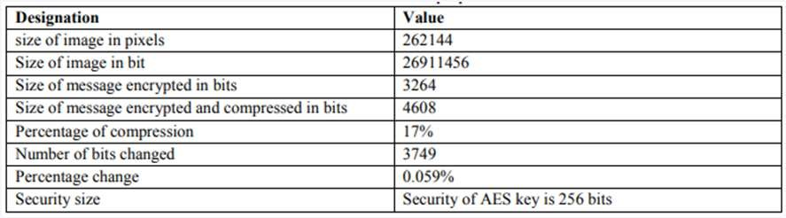
Literature Reviews
What Others have done in this area
A secure image steganography
Citation Number
Secret Communication using Multi-
Citation Number
technique to hide multimedia files in
RGB images
April 2018
Proposed Methods :Embedding phase , Extraction phase
Results Parameters with Accuracy :The standard PSNR value for maintaining visual imperceptibility is PSNR of the stego images with above 30 DB .If the PSNR is above 30 DB then the secret data hidden cannot be detected by a normal vision. The obtained PSNR value of stego 1 is 33DB and of stego 2 is 34 DB. The PSNR values are calculated by comparing the stego images with original cover images.
ImageSteganography for Military
Purposes
July 2022
Data Set Used :Multi-Image Steganography, Cryptography, Least Significant Bit LSB Steganography, Advanced Encryption Standard AES Cryptography, Information Hiding
Proposed Methods :LSB Steganography
Results Parameters with Accuracy :

Slide 8






Research Gap and Motivation
Used for watermarking and trademarking
Image extensions excepted : JPEG , png
No image size boundations. User friendly.

Slide 9







Proposed Methodology
Language Used: JavaScript
Library Used: steganography.js
Steganography technique Used: LSB steganography

Slide 10

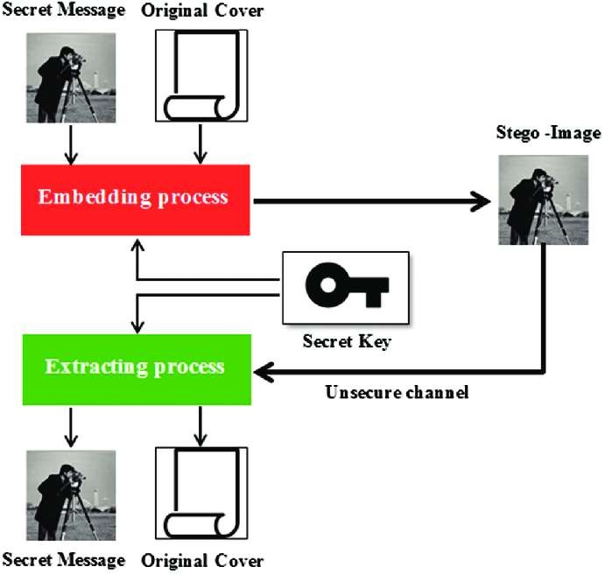
Proposed Methodology Architecture

Slide 11




Discussion on Proposed Methodology
Cover-Image
Unique picture that can conceal data.
Stego-Image
A stego image is an image with a hidden message.
Message
Real data that you can mask within pictures. The message may be in the form of standard text or an image.
Stego-Key
Messages can be embedded in cover images and stego- images with the help of a key, or the messages can be derived from the photos themselves.

Slide 12
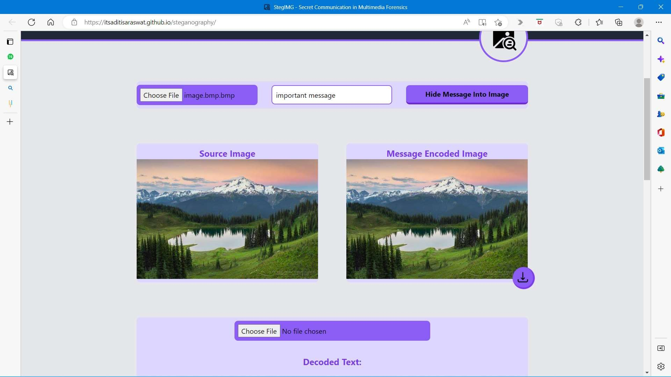
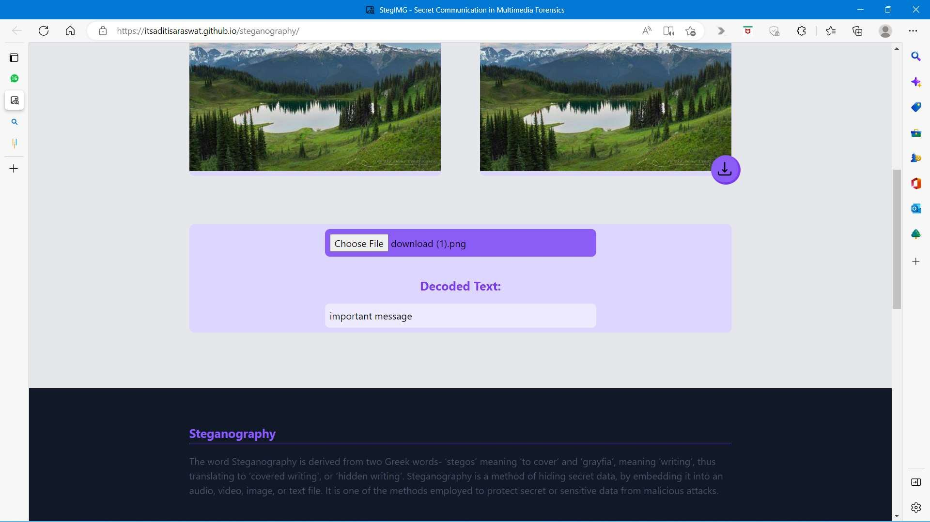
Experiments and Results
Browsers which support HTML5 canvas element

Slide 13

Conclusion and Future Work
Summary
01
Confidentiality
02
Integrity
In future, we are considering using audio files for hiding message for secret communication as StegIMG tool does not hide secret messages in audio files due to the lack of the appropriate tools. To achieve this, more extended tests are required in order to validate and confirm the outcomes derived in this work.

Slide 14
References
IJSTR VOL-8, ISSUE 12, DECEMBER 2019: Image Steganography Using LSB by Dr.Amarendra K
“Image Steganography Applications For SecureCommunication”, Tayana Morkel, 2012
“Image Steganography Technique Based On PredeterminedPattern And Histogram Analysis”,Haya Mohammad Al Haj
Image Steganography Explained | What is Image Steganography?
(mygreatlearning.com)
multimedia_forensics.fina11.pdf (columbia.edu)

Slide 15





Any Queries

Slide 16

Thank You

